Slide 1
VERONICA & COLIN’S WEDDING
MAY 2ND, 2026
50 GUESTS
CHÂTEAU D’AVENY
WEDDING MOOD BOARD

Slide 2
COLOR PALETTE
MAY 2ND, 2026:
CEREMONY: WHITE/DUSTY BLUE
BOUQUET: WHITE/DUSTY BLUE
COCKTAIL & RECEPTION/DINNER: WHITE/DUSTY BLUE
WELCOME PARTY: WHITE/GREENERY/PASTEL COLORS
BRUNCH: WHITE/GREENERY/PASTEL COLORS

Slide 3
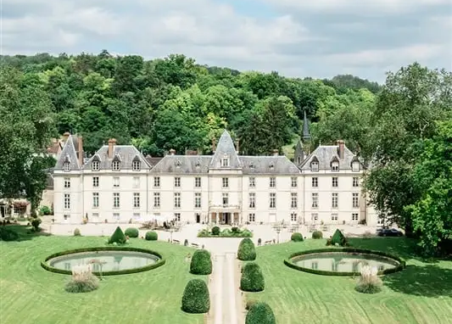
CEREMONY DECOR
The ceremony will take place at Château d’Aveny

Slide 4
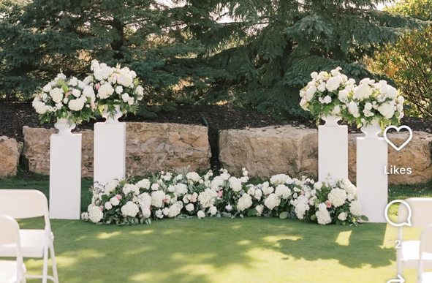
ALTAR DECOR
White and dusty blue floral arrangements will be placed atop columns in white antique vases, as shown in the reference image, elegantly framing the ceremony space
A large, lush floral arrangement will be artfully set on the floor between the columns, enhancing the space with a refined and romantic touch

Slide 5
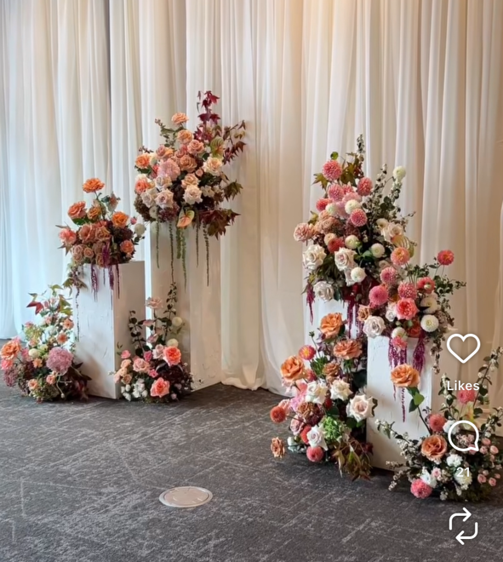
CEREMONY DECOR – AISLE ENTRANCE
White and dusty blue floral arrangements will be placed atop columns of varying heights on each side of the aisle entrance, elegantly framing the ceremony space
Additional floral arrangements will be placed at the base of the columns, as shown in the reference image

Slide 6
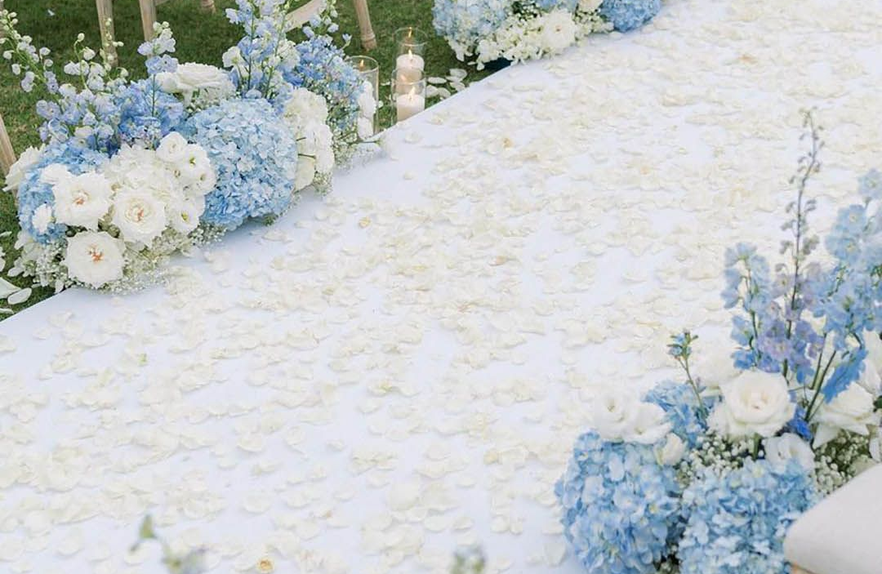
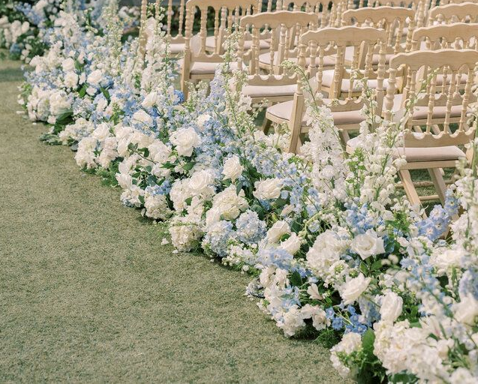
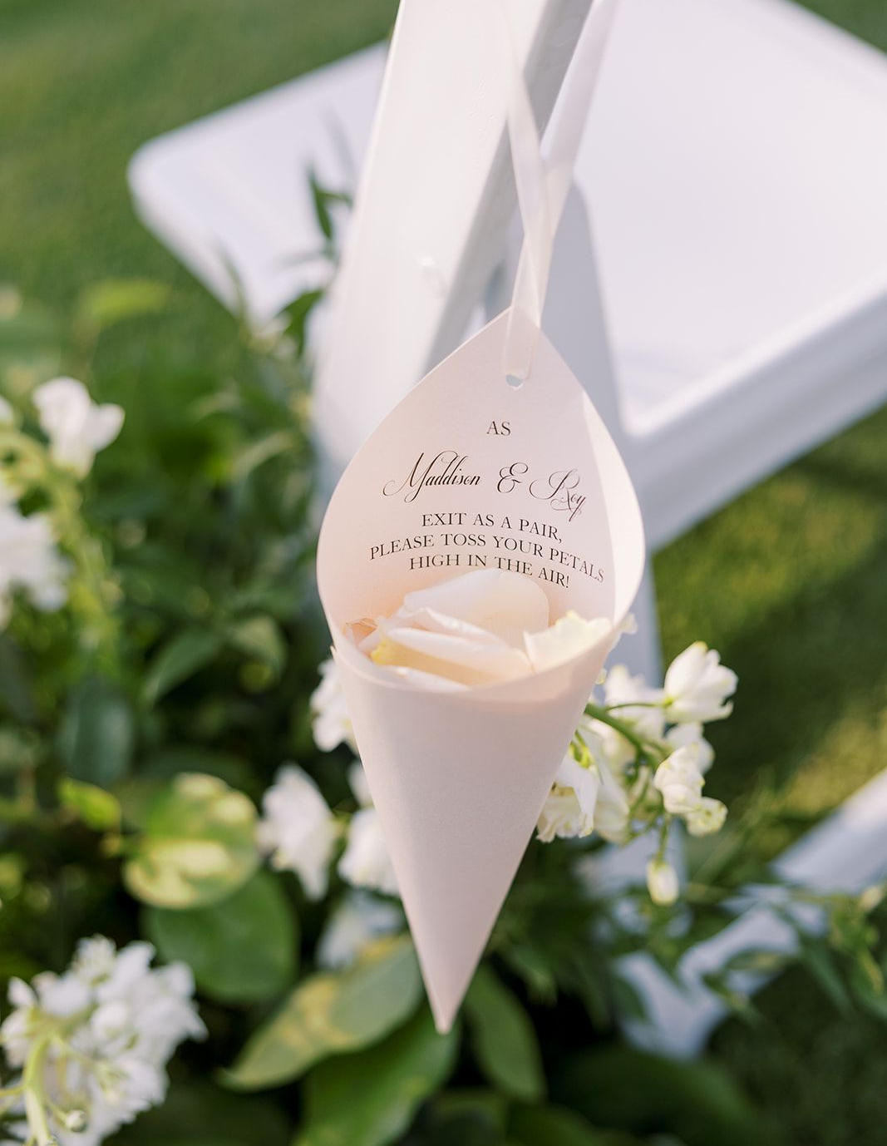
AISLE DECOR
White and dusty blue floral arrangements will be artfully placed along both sides of the aisle, with white loose petals scattered throughout the aisleway
White loose petals will be placed inside cones and delicately tied to the chairs for guests

Slide 7
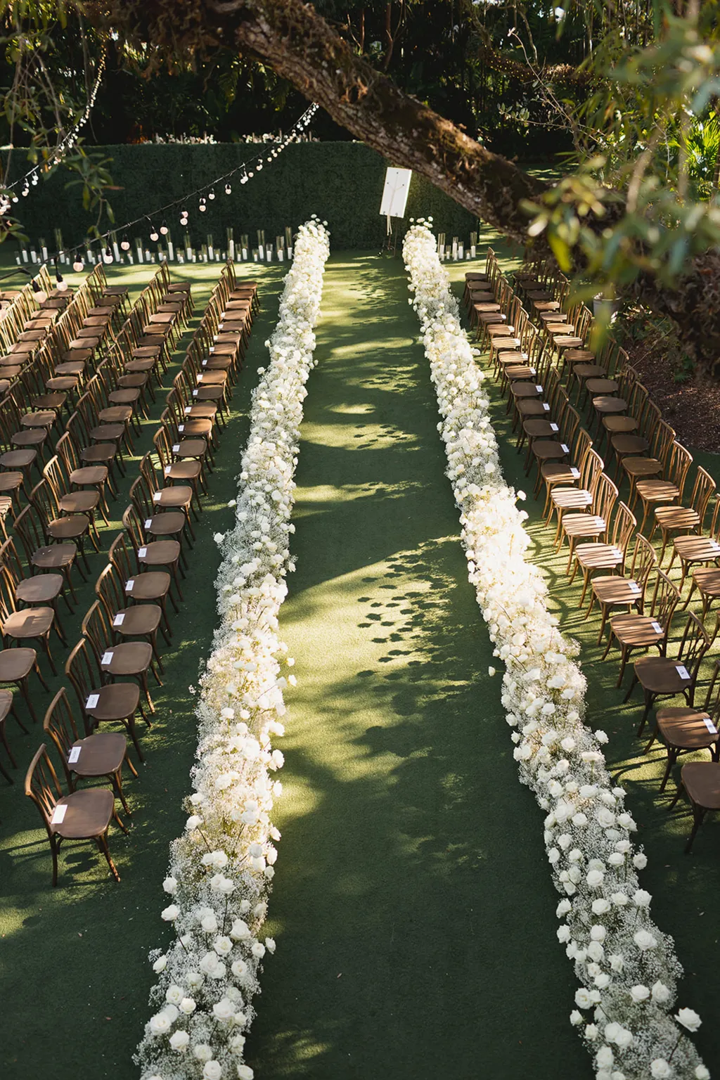
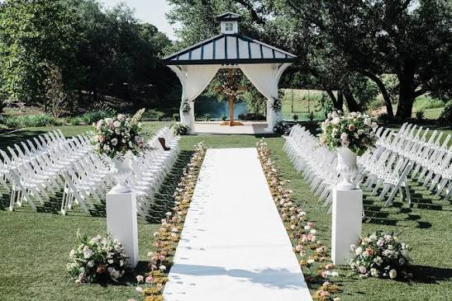
AISLE CHAIRS ARRANGEMENT
During the ceremony, the chairs may also be arranged as shown in the reference images. TBD

Slide 8
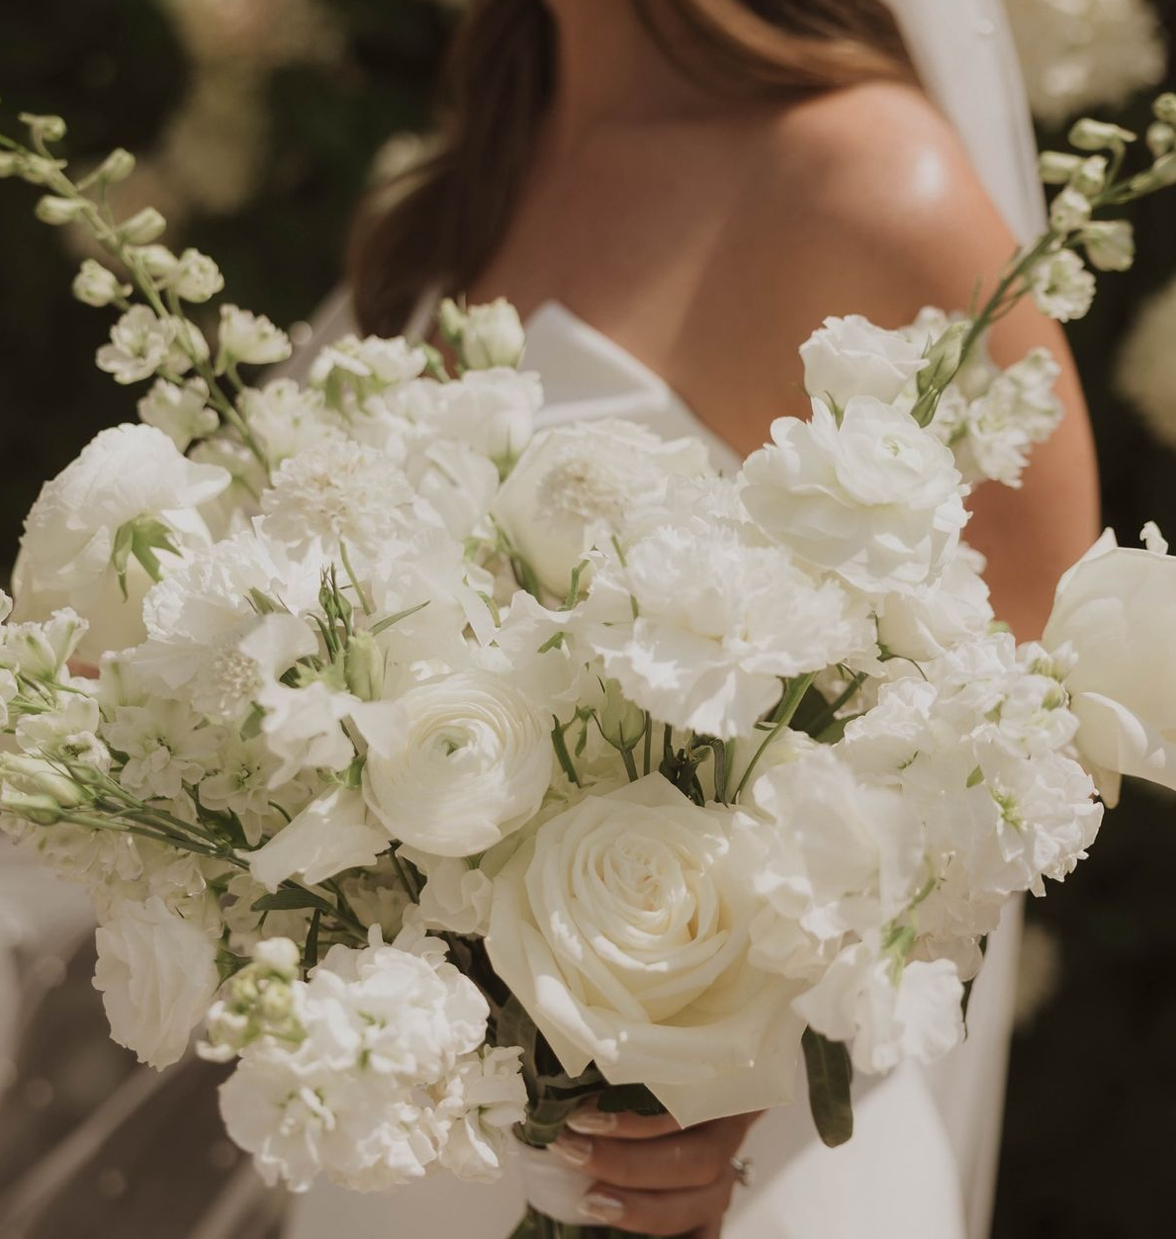
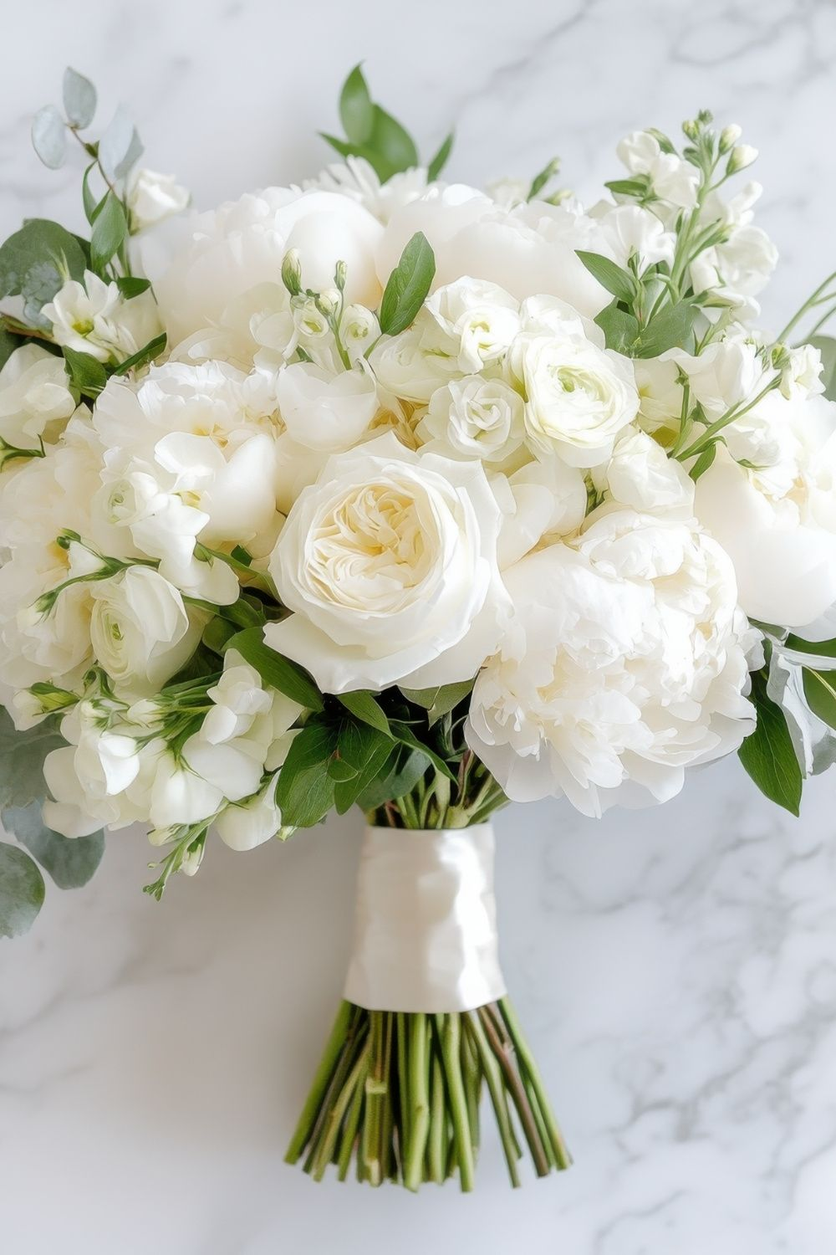
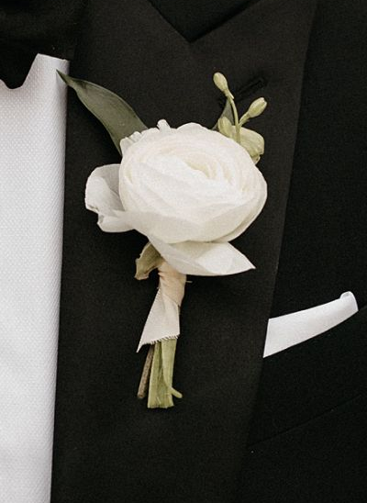
BRIDAL BOUQUET & BOUTONNIERE
Bridal bouquet: The bridal bouquet will be medium in size, composed of an airy and refined blend of white spring florals, inspired by the reference image. The stems will be finished with a white ribbon, delicately tied to create a natural, effortless finish
Boutonniere: The boutonniere will feature a wild spring bloom, delicately enhanced with a white ribbon

Slide 9
BRIDEMAIDS BOUQUETS
The bridesmaids’ bouquets will mirror the bride’s bouquet in style, with a slightly smaller scale. As discussed, six bouquets will be created

Slide 10
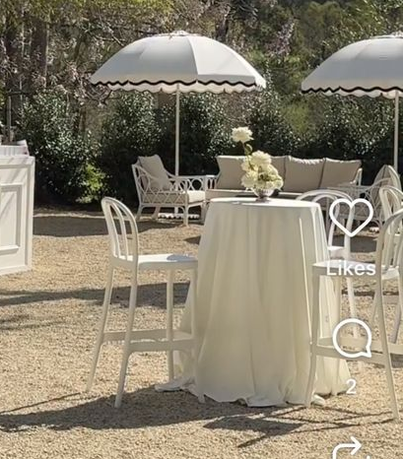
COCKTAIL
A curated arrangement of lounge tables, accented with elegant white drapery, will offer guests an inviting space to unwind in an atmosphere of understated elegance
Each table will feature delicate white floral arrangements, presented in small antique vases

Slide 11
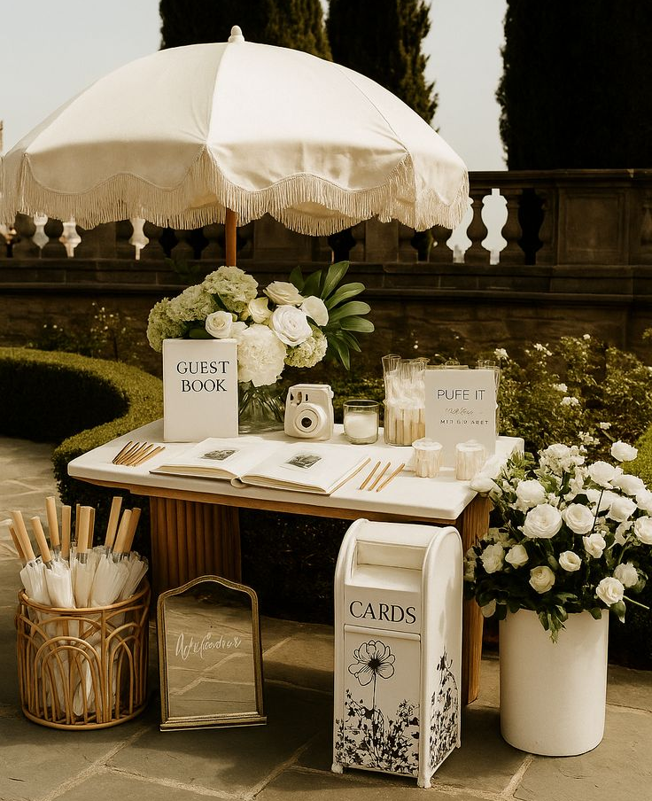
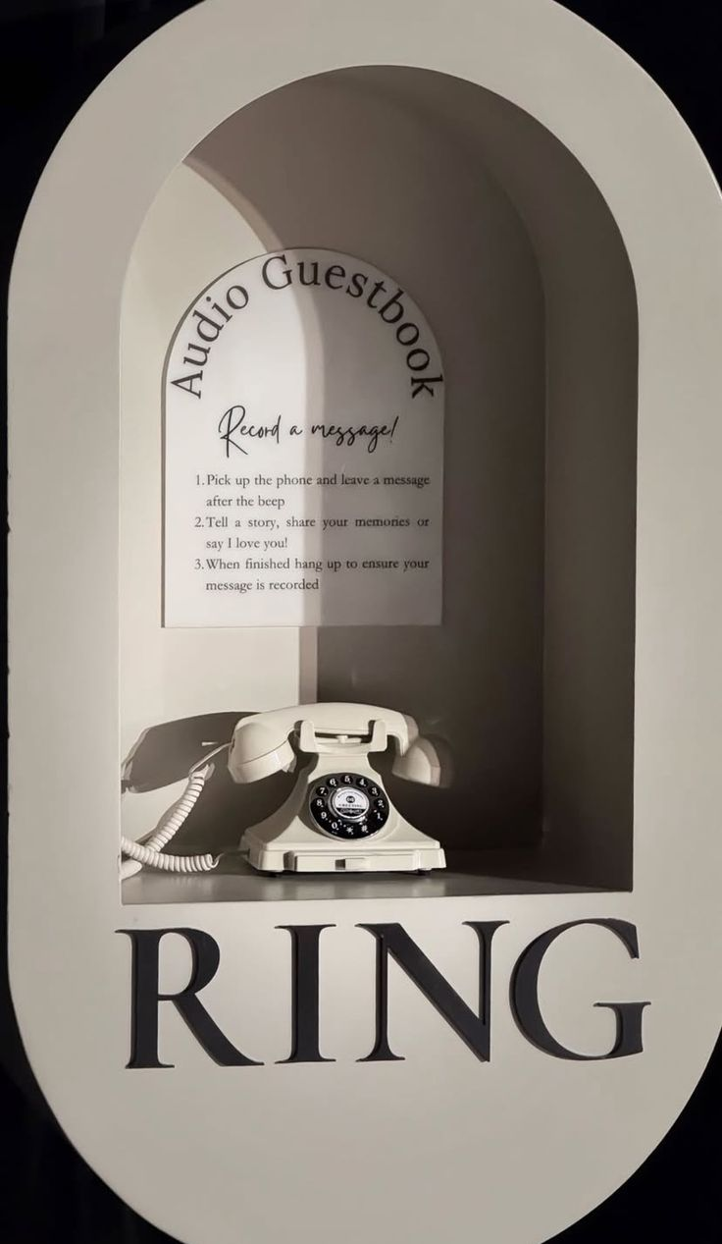
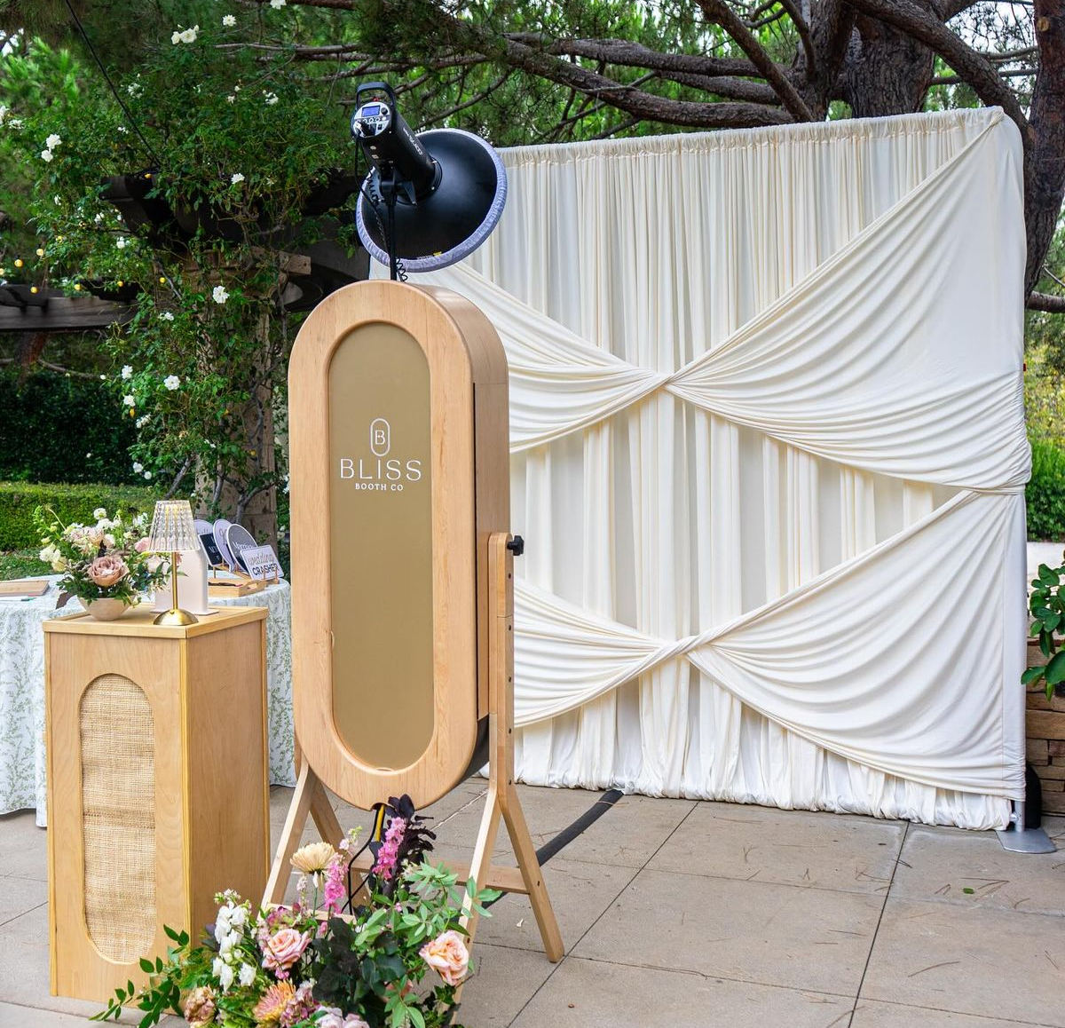
COCKTAIL
Paper and audio guestbooks will be displayed and available for all guests, as shown in the reference image
A white and greenery floral arrangement will be placed both on the table and at its base, accompanied by a letter box and a wooden basket of umbrellas
A softly draped wall will be provided as an elegant backdrop for the photobooth area, inspired by the reference image

Slide 12
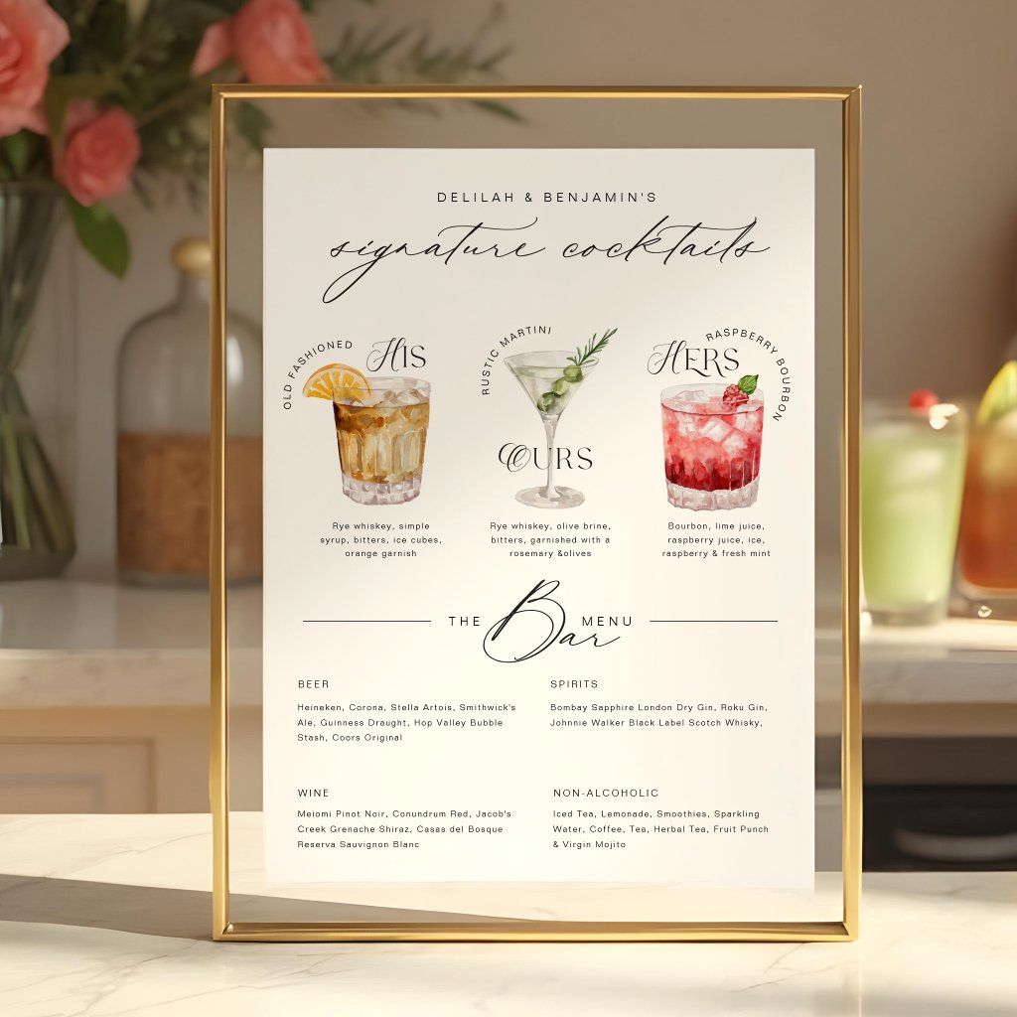
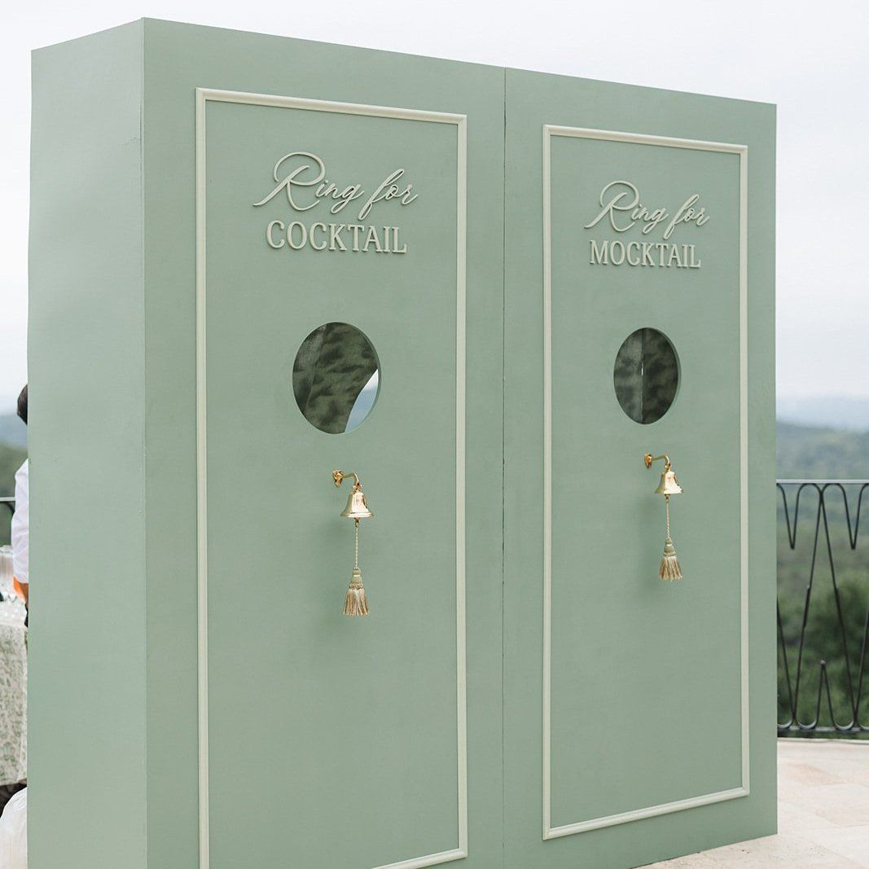
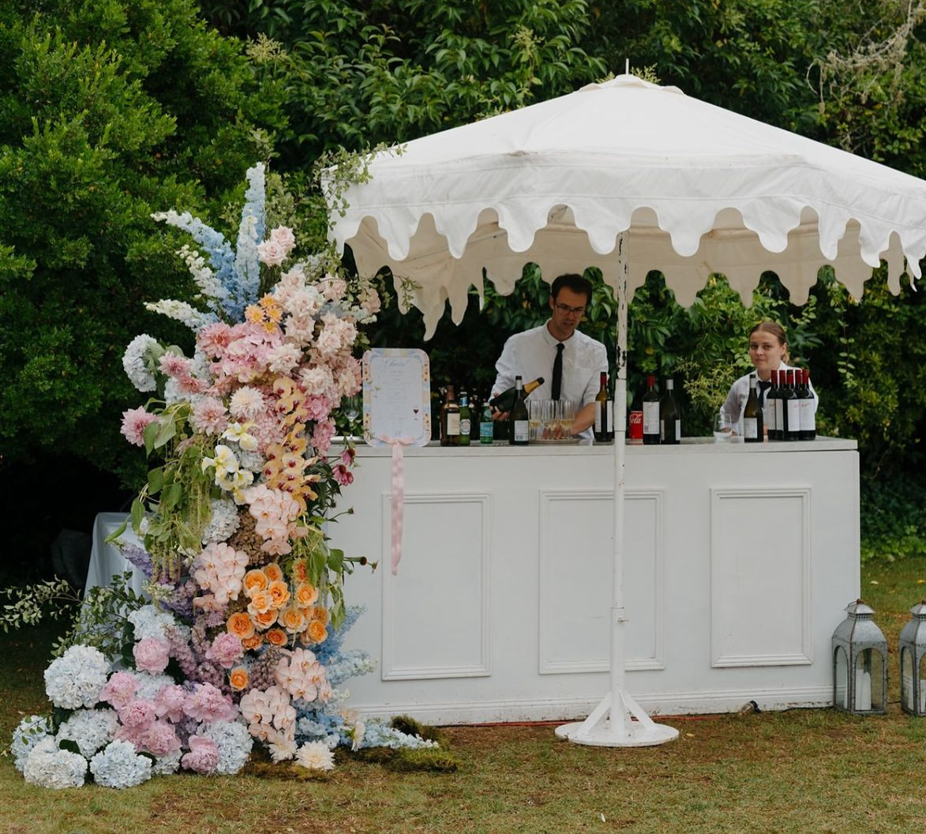
BARS RENTAL & DECOR
A refined white bar, inspired by the provided reference image, will anchor the cocktail space, complemented by a tall white and dusty blue floral arrangement placed at its base
The bar menu will be displayed in a glass gold frame, showcasing the selected beverages
A white ‘ring the bell’ structure will be set at the bar, as shown in the reference image
The décor will echo the reference imagery, styled in harmony with the color palette detailed on slide #2

Slide 13
SIGNS
Audrey’s note: To create an harmony between the differents signage I recommend using the same font style and color (as much as possible) – TBC with Veronica a design proof will be sent.

Slide 14
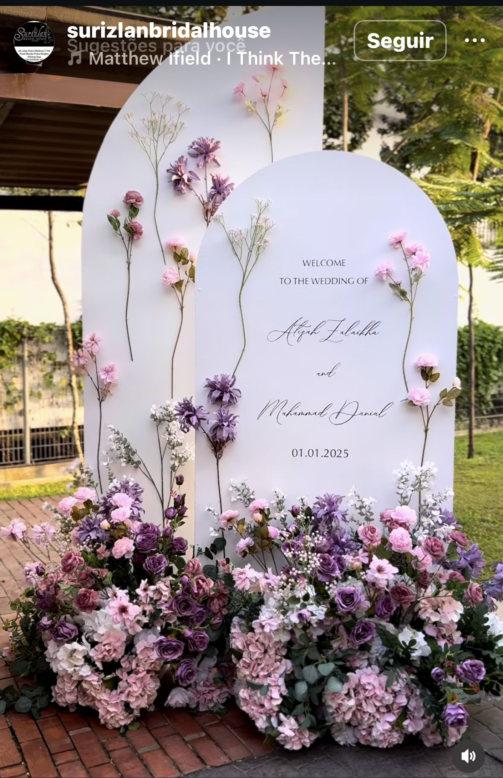
Welcome Sign & Décor
The white welcome sign, featuring typography and detailing inspired by the reference image, will be elegantly paired with a floral arrangement in white and dusty blue, creating a sophisticated and inviting entrance

Slide 15
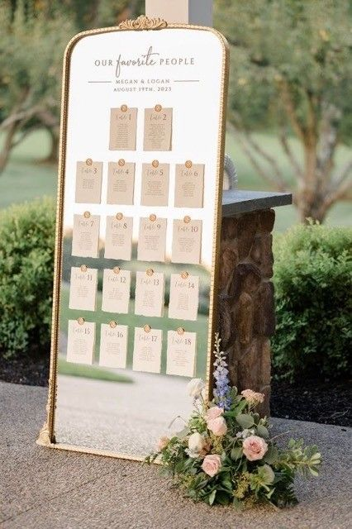
Seating Chart
A large rectangular gold-framed mirror will display the seating chart, featuring wax-sealed, gold-stamped cards elegantly presenting each table number and guests’ names
A medium-sized floral arrangement will be displayed at the base of the seating chart, with décor echoing the reference imagery and styled in harmony with the color palette detailed on slide #2

Slide 16
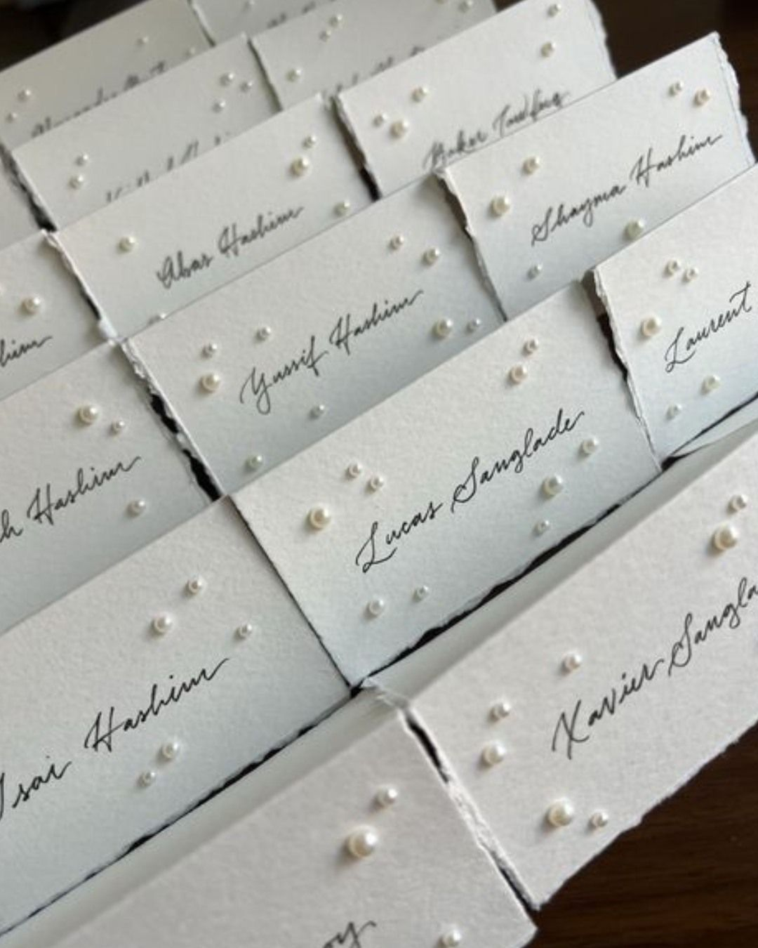
Place Cards
Audrey’s Note:
Please note that place cards are required by the catering staff regardless of round or rectangular tables. For weddings with more than 100 guests, place cards must be placed on each table with assigned seating, showing each guest’s full name, table number, and a meal icon/allergy note to guide the staff.

Slide 17
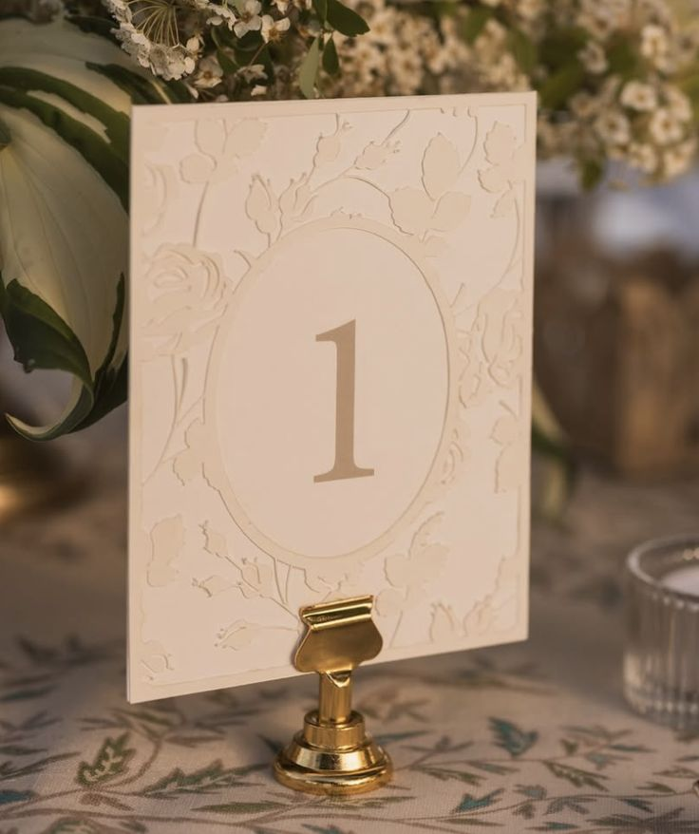
Table numbers
A refined rectangular design, printed on white paper and enhanced with warm-white floral motifs and gold script typography, will be elegantly displayed on a gold holder

Slide 18
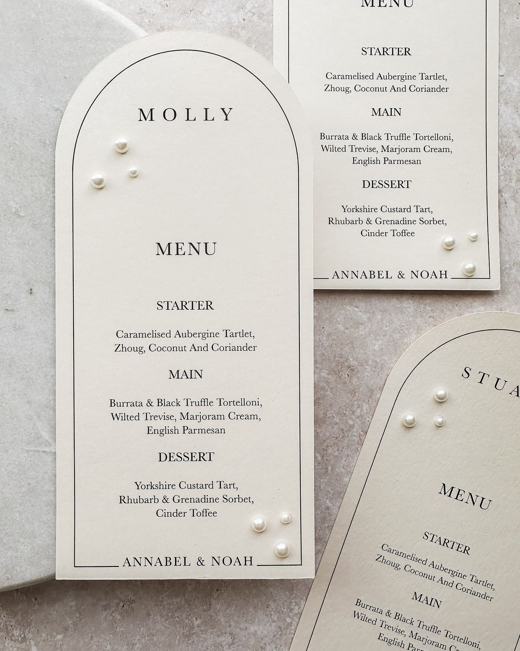
Menus
A large rectangular format with a rounded top, crafted from white, smooth, thick matte paper, featuring elegant dark script typography and enhanced with white pearls for a sophisticated, harmonious touch

Slide 19
RECEPTION DÉCOR

Slide 20
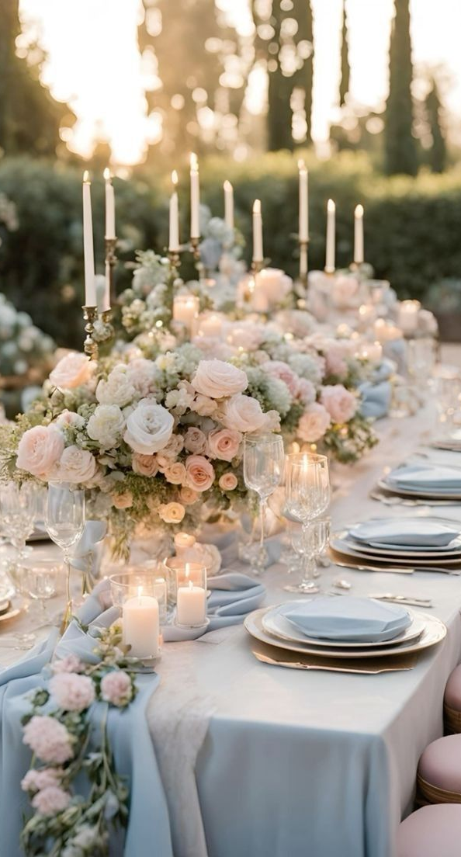
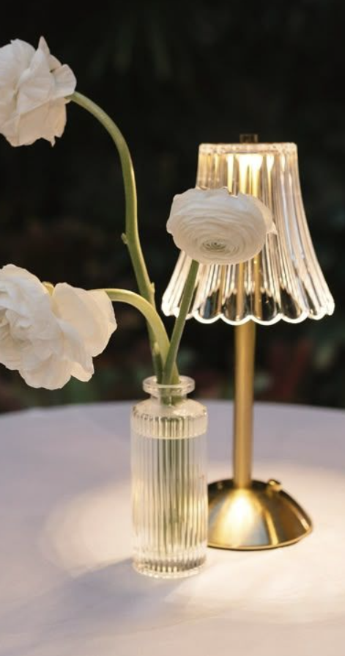
Rectangular Tables – OPTION 1
Rectangular tables (12 to 14 peoples) will be dressed in warm white linens and adorned with airy floral arrangements in crystal vases, elegantly arranged from end to end
These arrangements will incorporate short taper candles, complemented by vintage mini lamps.
The overall décor will reflect and harmonize with the color palette detailed on slide #2

Slide 21
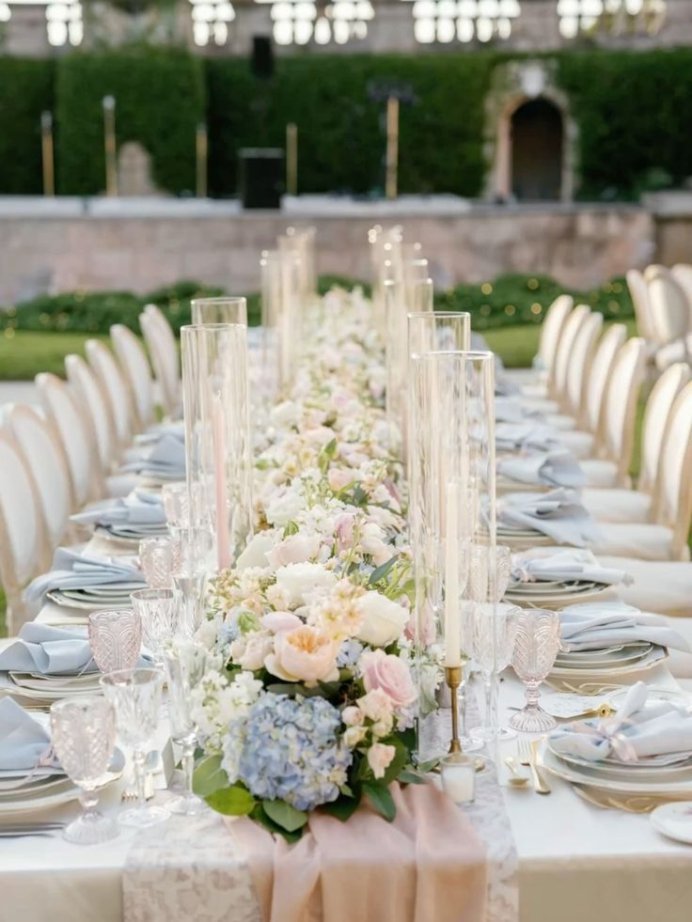
Rectangular Tables – Option 2
For the rectangular table décor, the aesthetic remains light, airy, and romantic. Each table will feature multiple medium-low, rounded floral arrangements, elegantly placed from end to end in small vases and surrounded by medium white taper candles. A refined palette of pastel blues, soft whites, and lush greenery envelops the space, creating a warm, timeless, and effortlessly sophisticated ambiance

Slide 22
RENTALS

Slide 23
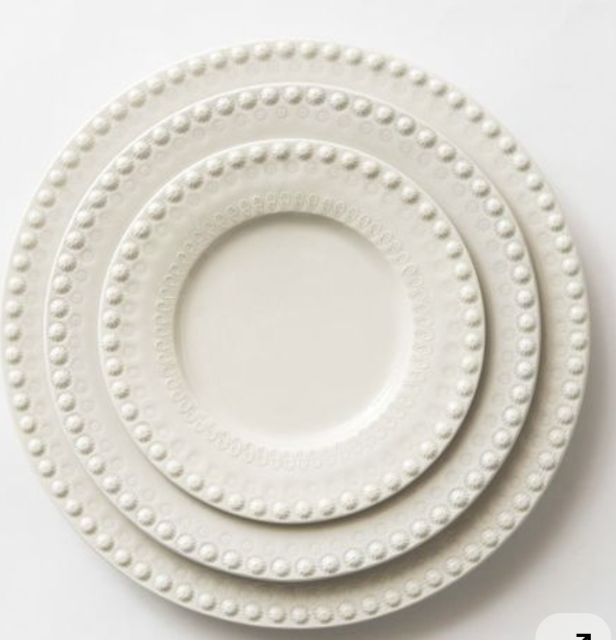
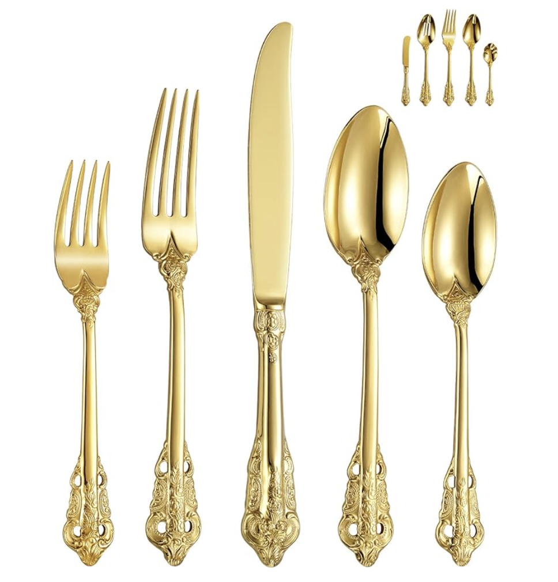
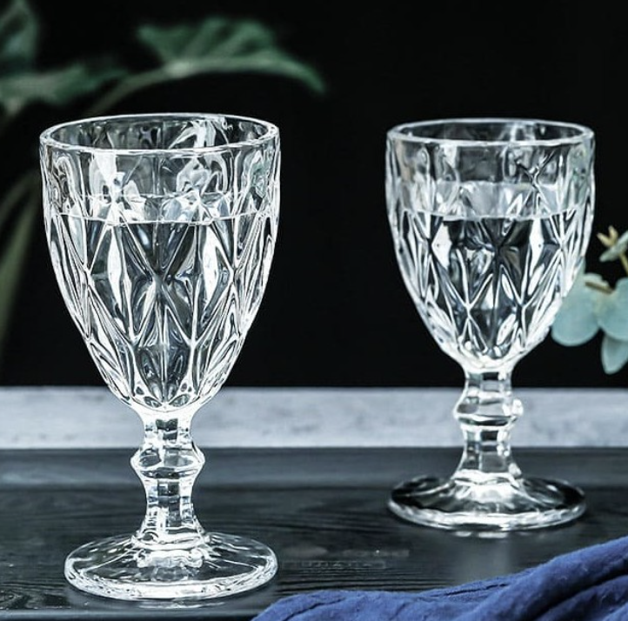
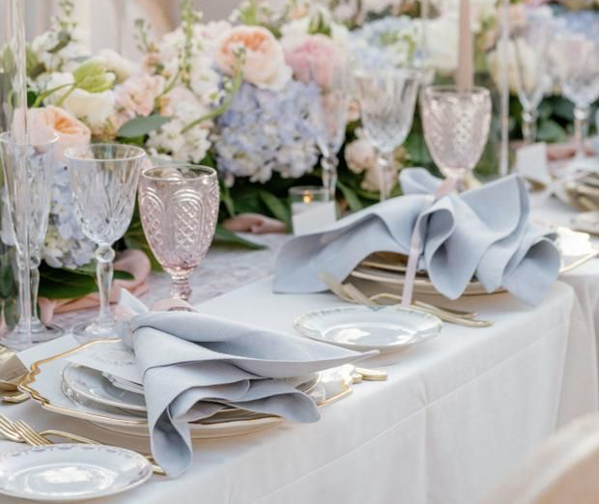
TABLEWARE
Ivory or gold rimmed charger plates will be selected based on rental availability, carefully chosen to match the reference image provided by the bride. Vintage gold flatware will complement the table setting, paired with delicate crystal glassware and dusty blue napkins for a refined and harmonious touch

Slide 24
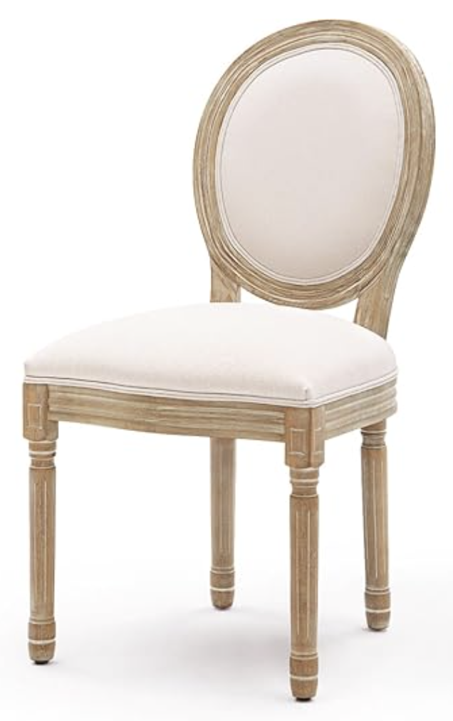
CHAIRS FOR CEREMONY AND
RECEPTION
WOODEN - Louis Chairs

Slide 25
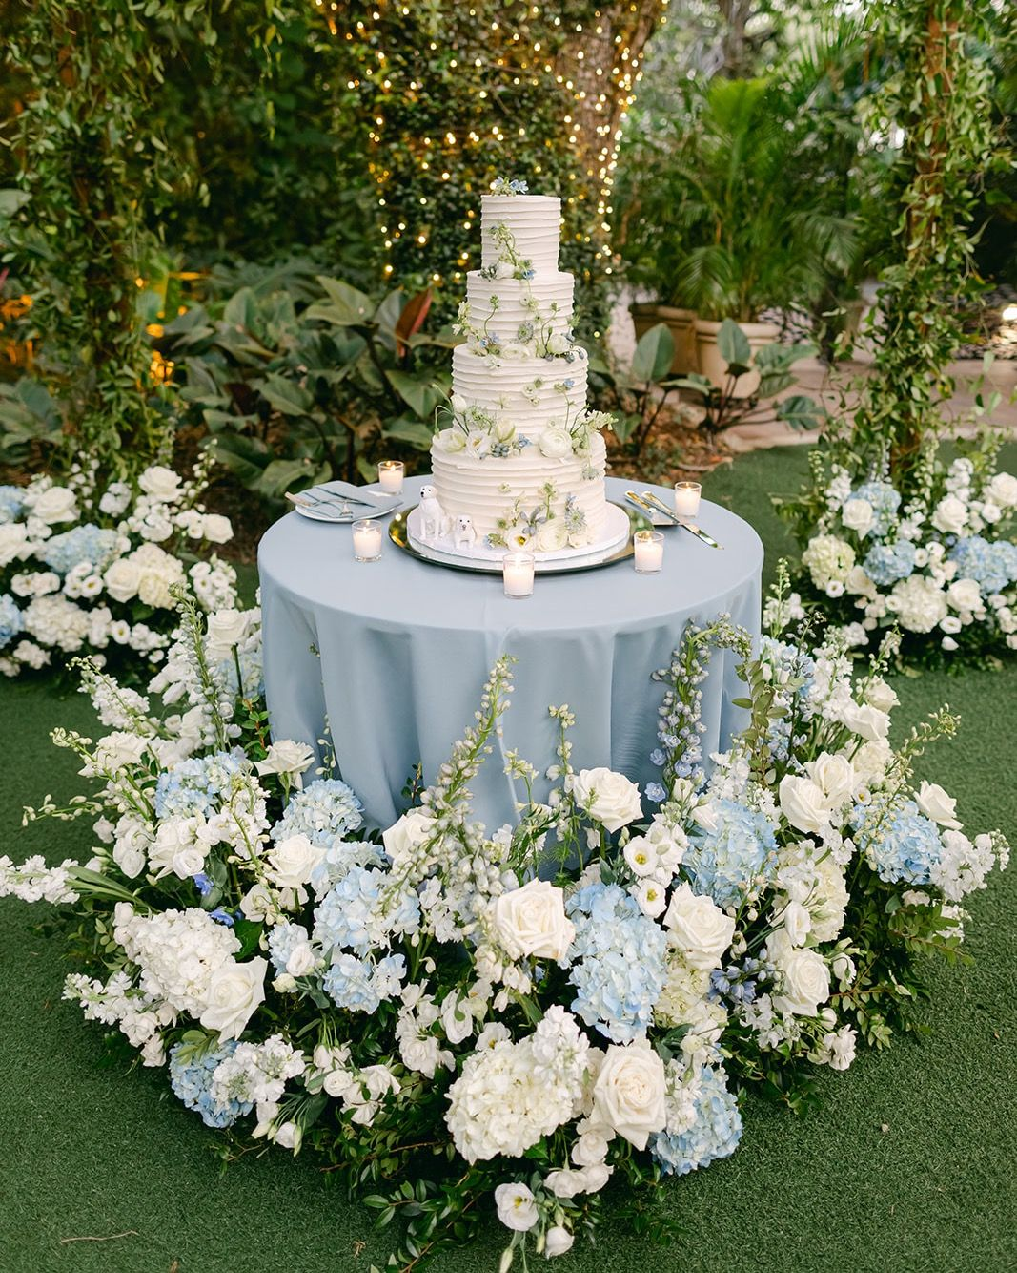
CAKE TABLE
The cake table will be styled with floral arrangements that harmonize seamlessly with the overall décor, in keeping with the established color palette

Slide 26
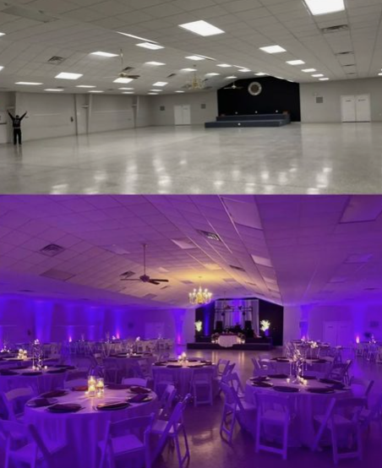
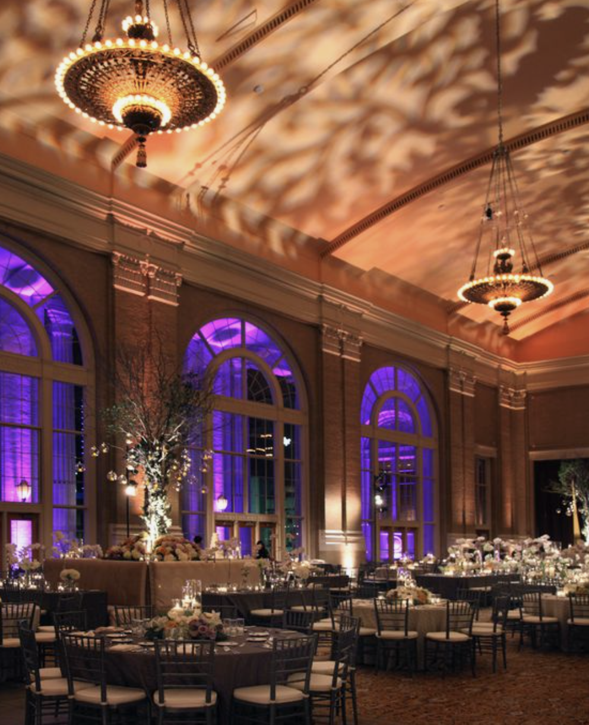
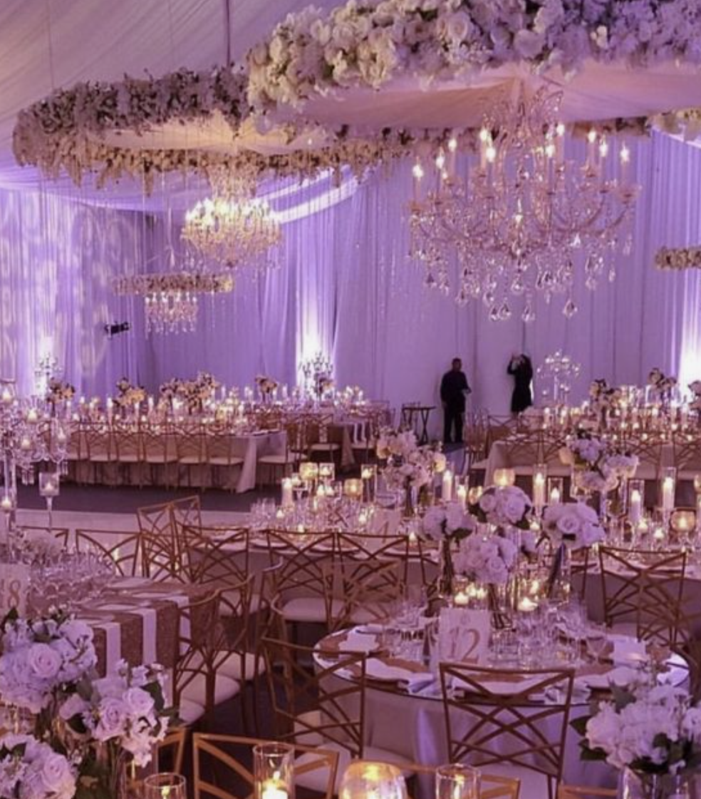
UP LITHING
Audrey’s Note: I highly recommend considering uplighting for your décor. It has a remarkable ability to enhance the overall ambiance by highlighting key elements and adding warmth to the space. Uplighting can truly transform your event, creating a captivating and inviting atmosphere that your guests will love.

Slide 27
FLOOR PLANS

Slide 28
RECEPTION/DINNER SEATING PLAN
The finalized floor plan will be shared upon confirmation of the final guest list

Slide 29
WELCOME DINNER
TBD depending on the venue.

Slide 30
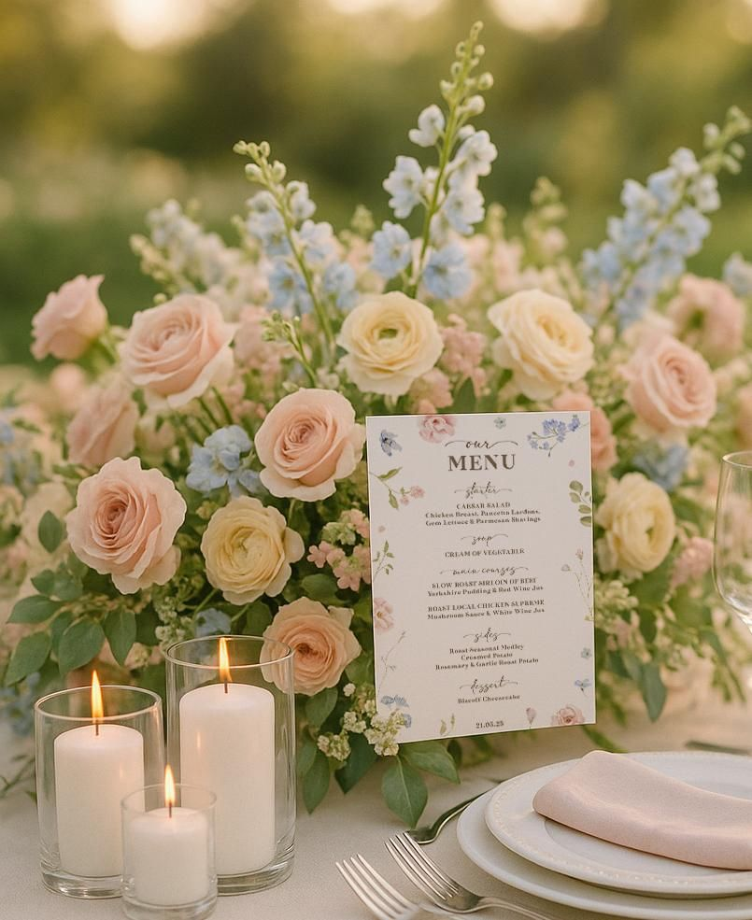
A pastel floral arrangement will be placed on each table, accompanied by a cluster of small votive candles, creating a light, sophisticated, and effortlessly elegant ambiance

Slide 31
BRUNCH
TBD depending on the venue.

Slide 32
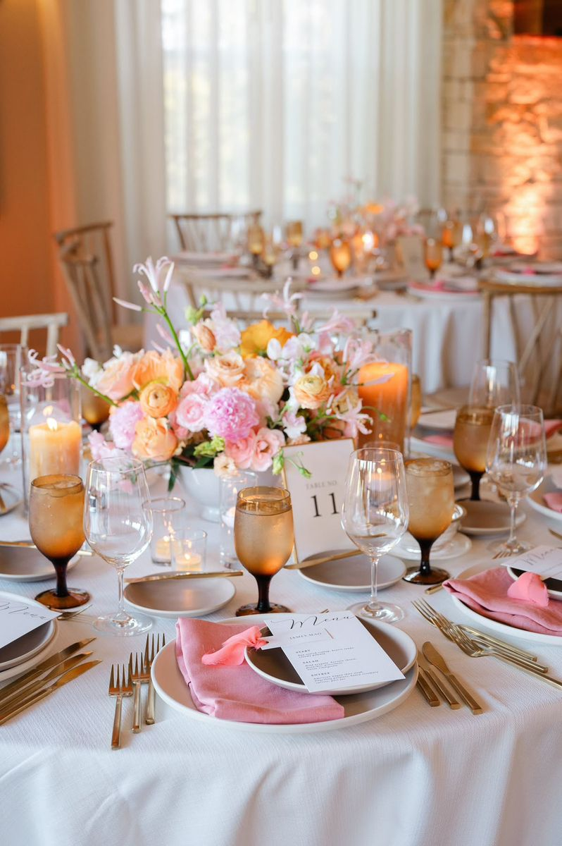
A wild spring pastel floral arrangement will be placed on each table, displayed in small white vases and complemented by small votive candles, creating a warm, sophisticated, and effortlessly elegant ambiance

Slide 33
We can’t wait to bring your vision to life!
The concepts (written and images) in this proposal are symbolic of the design inspiration we intend to bring to life for your event. Due to the characteristics of perishable items (flowers), there can be situations that may emerge that are completely out of our control.
To protect the integrity of our creativity, we kindly ask that you do not share the details of this proposal with other vendors bidding for your event. This was made just for you. However, please feel free to share this with your family.

Slide 34
NOTES FOR PLANNER AND FLORIST TEAM ONLY (FRENCH):
Décor de la Cérémonie + décor de l’allee 1 Bouquet de mariée
1 Boutonnière du marié
6 Bouquet de demoiselles d'honneur
TBD Tables rectangulaire
TBD Table des maries
6 décor Tables mange debout pour l'heure du cocktail
2 Décor de Bars (1 pour le cocktail - 1 pour la réception/fête)
1 décor pour le welcome sign / panneau de bienvenue
1 décor pour la Table “Welcome” Table
Re disposition des fleurs pour la table du Wedding Cake
REHEARSAL DINNER
TBD
BRUNCH
TBD

